Slide 1
TK2100: Informasjonssikkerhet Lesson 07: Network 2
Dr. Andrea Arcuri
Westerdals Oslo ACT
University of Luxembourg

Slide 2
Goals
Understand how DNS works, and why it is insecure
Understand how to carry out a web site phishing attack

Slide 3
Domain Name System (DNS)

Slide 4
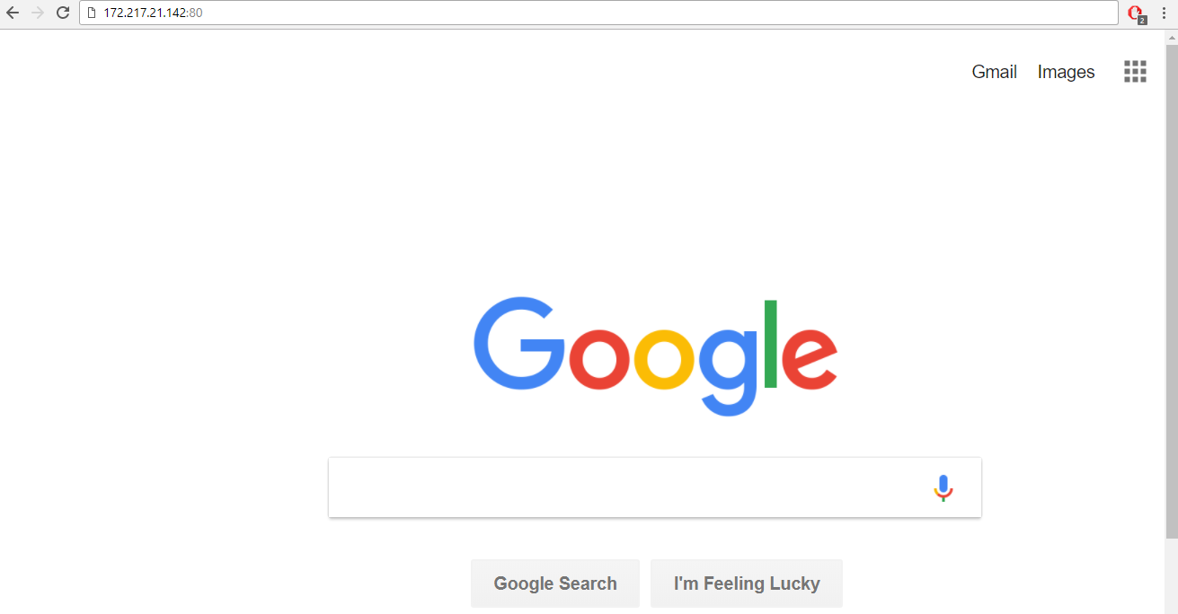
How many of you type IP addresses like 172.217.21.142 when browsing the internet?

Slide 5
Hostnames
Network/Transport protocols like TCP/IP have NO knowledge of hostnames like www.google.com or www.facebook.com
But asking users to remember and manually type IP addresses like 172.217.21.142 is not viable
Need something that can translate/map from hostnames to IP addresses
Also extra benefit that you can change IP addresses without the need of clients to update (as they use the hostnames)

Slide 6
Domain Name System (DNS)
Application Layer protocol used to find IP addresses from hostnames
There exists DNS servers that can be contacted to do the hostname mapping
ICANN: Internet Corporation for Assigned Names and Numbers
You can pay a fee to register a hostname, and choose to map it to an IP address of your choice

Slide 7
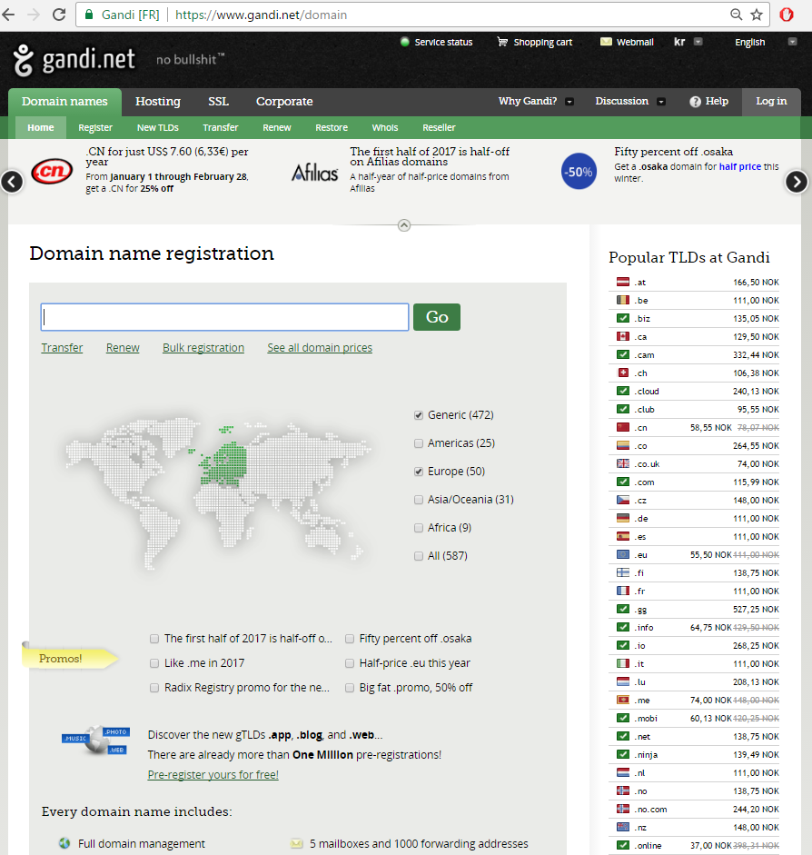
Registering a domain mapped to an IP address of your choice is not particularly expensive: eg 139 NOK per year for a “.no” address
For example, I used it to register “arcuriandrea.org”

Slide 8
Hierarchy
Domain names are organized in a hierarchy, which is read from right to left
Consider the hostname “kristiania.no”
“no”: is a top-level domain, representing Norway
countries have their own, like “au” for Australia and “it” for Italy
There also generic ones like “com” and “org”
“kristiania.no”: a subdomain of “no”

Slide 9
What about “www”?
WWW stands for World Wide Web
“www.kristiania.no” is a subdomain of “kristiania.no”
they are 2 DIFFERENT hostnames
they can be mapped to same IP address, or different ones
although it is more common to use 301 HTTP permanent redirection (will see later in the course)
Why?
Historical reasons, to make clear that “www.foo.com” was something you could type in this revolutionary new thing called internet browser… just using a “.com” was not clear enough when internet was first introduced in the 80s/90s
Might have different servers for different applications (eg email server) and want to use same main domain “foo.com”, where “www.foo.com” is a subdomain just for the HTML pages

Slide 10
Distributed Database
.com
.org
.it
.no
google.com
facebook.com
vg.no
kristiania.no

Slide 11
Many Servers
The root DNS server has information of where to find (ie IP) the servers of the top-level domains (eg, “.com” and “.no”)
Top-level servers have info of where to find hosts in their subdomains
Eg, server for “.no” will have info for “kristiania.no” and “google.no”, but not “google.com”
National top-level domains are usually handled by government institutions in such countries
eg in Norway handled by Norid, own by the Norwegian Ministry of Education and Research

Slide 12
DNS Resolution
Let’s say you need to find out IP address of “www.kristiania.no”
First contact root server, which will answer by saying where to find server handling “.no”
Then contact this latter one, which can give the IP or redirect to yet another DNS server in subdomain
And so on recursively until finding a DNS server with the record for “www.kristiania.no”

Slide 13
Where is www.example.com?
root
DNS server
Try .com DNS server
.com
DNS server
Where is www.example.com?
Client
Try example.com DNS server
Where is www.example.com?
example.com
DNS server
208.77.188.166

Slide 14
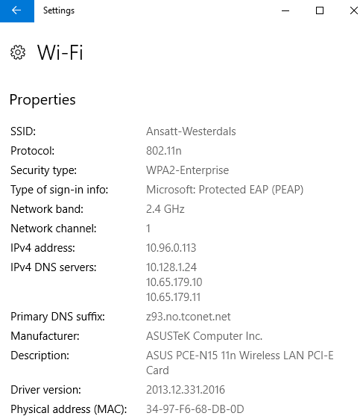
But how to find IP of DNS server?
Could be hardcoded
Or, in LANs, can be returned as part of DHCP messages when assigning IP address
LANs will usually have their own DNS servers that query the main ones on the client behalf
Note the local IP 10.x.x.x addresses for the DNS servers (can be more than one)

Slide 15
Where is www.example.com?
Try .com DNS server
LAN DNS
Where is www.example.com?
Client
Where is www.example.com?
Try example.com DNS server
208.77.188.166
Where is www.example.com?
208.77.188.166

Slide 16
Caching
Having to query the root DNS servers each time a hostname needs to be resolved would put a lot of stress on such servers
There are several billions of machines connected to internet which would need to contact those DNS servers
Using caches to avoid asking for hostnames that have already been resolved before
Caches in different places: browser, OS, LAN DNS, etc

Slide 17
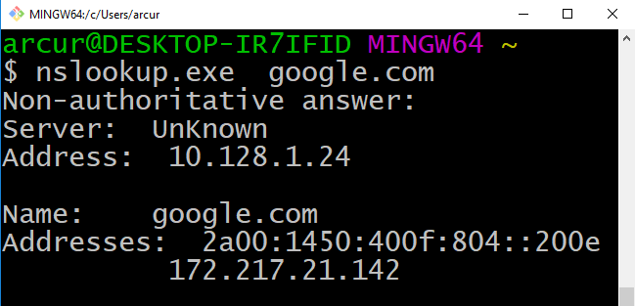
“nslookup”
Note the IP of LAN DNS
Getting both IPv4 and IPv6

Slide 18
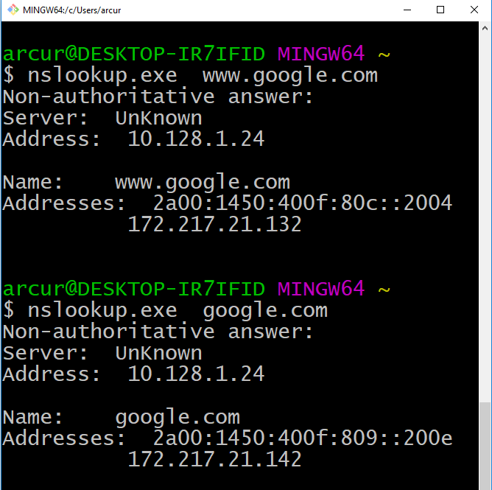
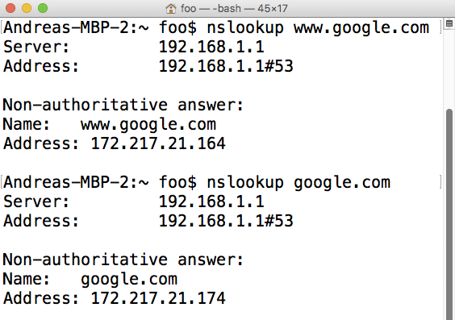
In this case, “www.” results in different IP address
Also from different networks with different DNS caches, could get different IP addresses… eg Google does not have only a single machine serving “www.google.com” …

Slide 19
Time-to-Live (TTL)
Caching is critical for performance
But mapping from hostnames to IP addresses can change
In DNS protocol, each record has a TTL entry
eg, the mapping is only valid for 1 day
When TTL expires, need to remove from cache, and ask DNS servers again
Tradeoff between performance (large TTL) vs. getting more recent / correct mapping (small TTL)

Slide 20
Subdomain Resolution
Assume you own “foo.com”
You might want to have different subdomains for it, like:
www.foo.com, email.foo.com, x.foo.com, y.foo.com, etc.
Example: you are a cloud provider, and want to give URLs for the web app you host:
clientAppName.foo.com, anotherClientApp.foo.com, etc.
You could register all of these hostnames with the root “.com” DNS server, but expensive and does not scale (especially when customers choose their own app names)

Slide 21
Cont.
Have your own DNS server under your registered “foo.com” domain
For example, your own server DNS running at “ns1.foo.com”
All your domains will be resolved by “ns1.foo.com” as the authoritative DNS for them
Example: “ns1.foo.com” would have the IP mapping for “clientAppName.foo.com” and “foo.com”
Can you spot the problem here?

Slide 22
.com
DNS server
Where is x.foo.com?
Try foo.com DNS server
Where is foo.com?
If your DNS server hostname is a subdomain of your registered domain, you can end up in a infinite loop!!!
Client
Try ns1.foo.com DNS server
OK, but where do I find ns1.foo.com?
Try foo.com DNS server

Slide 23
DNS Glue Record
To avoid infinite loop when subdomain “ns1.foo.com” is the authoritative DNS server for “foo.com”
When querying “.com” DNS server for “ns1.foo.com” , return directly its IP address without redirecting to its parent “foo.com”, even though “ns1.foo.com” is not a direct subdomain of “.com”, and “.com” is not the authoritative DNS server for it

Slide 24
DNS Attacks
If attacker can break the DNS protocol, could have disastrous consequences
Pharming: alter DNS records to redirect to malicious server
User might think to communicate with real “www.foo.com”, but instead is redirected to IP of a machine controlled by attacker

Slide 25
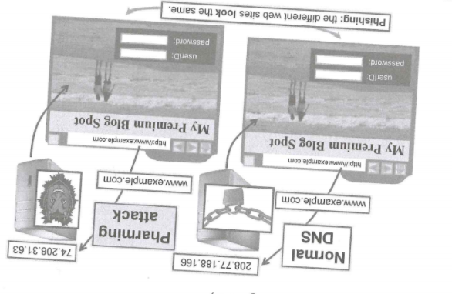
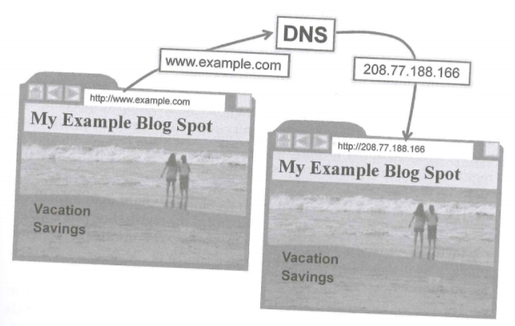
Pharming: Phishing
Trick user to type login/password in website that looks exactly the same

Slide 26
Pharming is not just Phishing
OS update/patch servers
Provide malware that is installed like it was patch update
Altering email servers
Etc.

Slide 27
DNS Cache Poisoning
Consider a target DNS server
eg the local one in a LAN
A cache poisoning attack is to alter its DNS records in the cache, eg by pointing them to your malicious servers

Slide 28
LAN DNS
.com DNS
Where is example.com?
Eve
Where is example.com?
example.com is at 208.77.188.166
Assume Eve wants to poison example.com
Eve sends DNS request for example.com
LAN DNS will send request to the authoritative DNS servers
BEFORE those do answer, Eve sends a crafted DNS reply to her own request stating that example.com is at an IP address of her choice
Eve needs to be fast: her message must arrive before “.com” replies

Slide 29
DNS Transaction Ids
To avoid spoofed DNS replies, DNS requests/responses do have a transaction id
When LAN DNS sends request to “.com” DNS, it will use an id, and expect the same id as response from “.com”
If different id, the DNS replies are ignored
Eve needs to predict which id the LAN DNS will use in its requests
Until 2002, most DNS servers were just using an incremental id
Eve just needed to intercept 1 request of LAN DNS, and will know the ids of all the following requests

Slide 30
LAN DNS
.com DNS
Where is foo.com?
ID=10: Where is foo.com?
Eve
ID=10: foo.com is at x.x.x.x
LAN DNS
.com DNS
Where is example.com?
Eve
ID=11: Where is example.com?
ID=11: example.com is at 208.77.188.166

Slide 31
Randomized Ids
Since 2002, DNS servers use randomized ids for the requests
DNS ids are 16-bit numbers, so 65_536 values
Eve can send more than malicious 1 reply, with different ids, hoping to get the right id
Just need 213 spoofed replies to have a 50% chances to get the right id
If interested, look at the Birthday Paradox to see the math behind it

Slide 32
Is DNS Cache Poisoning viable?
The time-frame for Eve to operate is too short
Still a chance that Eve guesses the right id, but quite low
Once a DNS record is cached, its TTL value might be days
In such cases, Eve would have to wait days before being able to attempt again
ie need to wait until TTL expires
The attack is feasible, but not so viable

Slide 33
Subdomain DNS Cache Poisoning
Type of viable attack found out in 2008
Let’s say Eve wants to poison “foo.com”
Eve makes false requests for non-existent subdomain like “idonotexists.foo.com”
LAN DNS server will send requests to the DNS of “foo.com”, which will NOT reply (as subdomain does not exist)
DNS protocol does not send error messages when hostname does not exist
Eve crafts her own replies for “idonotexists.foo.com”, and does not need to worry to beat in time the DNS server of “foo.com”, as that will never reply

Slide 34
LAN DNS
exampl.com DNS
Where is fake.foo.com?
Where is fake.foo.com?
Eve
fake.foo.com is at x.x.x.x
and, btw, here a glue record for its parent foo.com, with IP y.y.y.y for its DNS server
Poisoning the DNS entry of non-existent subdomain like “idonotexists.foo.com” achieves nothing in itself…
… but, Eve can have a “glue” record with a poisoned IP address for “foo.com”

Slide 35
How to defend from this?
LAN DNS are now usually not accessible from outside the LAN (it was not the case before 2008)
So, to do this attack, you need to be on the LAN
And yes, trying this attack on the LDNS in school is a really, really bad idea… unless you are planning to get expelled
But what about open WiFi in bars/restaurants/etc. ???
Port randomization
Each time DNS sends requests, use different UDP port, and expect answer on same port
Eve not only needs to guess DNS transaction id, but also the used UDP port, so around 64k times more combinations
Make Eve’s life harder, but attack is still viable

Slide 36
Client Side Poisoning
Instead of just attacking a LDNS server, can attack specific users and the cache on their machines
Can craft web pages requesting resources (eg images and CSS files) in non-existent subdomains
When browser loads the page, it will ask for the DNS resolution of these resources
Need a way to make user visit Eve’s web application
Once Eve knows that the page has been accessed, can send DNS replies to that user’s machine (the LDNS would not answer)

Slide 37
DNSSEC
Current DNS can be broken, as intrinsically insecure
Need to use a different protocol
DNSSEC is a DNS extension with encryption
But to work, both client and server need to support it
Slowly starting to replace DNS

Slide 38
Social Engineering and Phishing

Slide 39
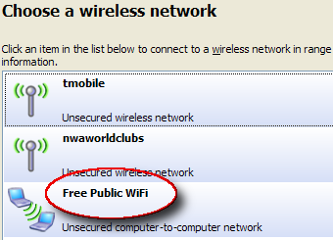
Open WiFi
Instead of poisoning an existing DNS server, have your own, and make users to connect to it
But how to lure them?
Just provide your own free WiFi service with a router, and give it an appealing name
When users connect to your router, it is you that give them the IP address and DNS server info…

Slide 40
Is it legal?
If you have illicit intent (eg, stealing info), then yes, most likely it is illegal
However, depending on the country, accessing a WiFi is illegal if the owner of the WiFi does not give permission
Eg, if someone connects to your WiFi, it might be them that are breaking the law
Florida 2005: man faced felony charges for using a neighbor's internet connection
Put in a different way: if you forget the door of your house open, that does not authorize people passing by to come in…

Slide 41
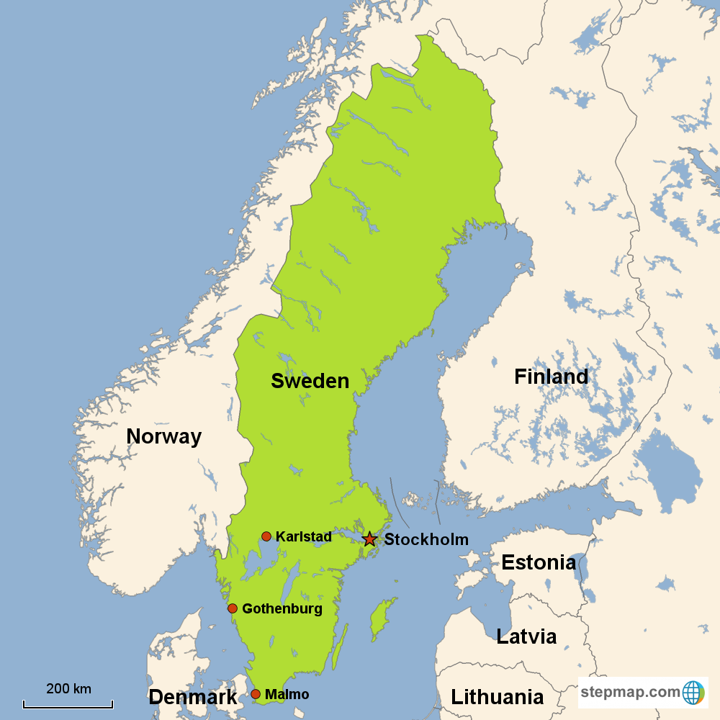
Let’s Talk About Sweden…

Slide 42
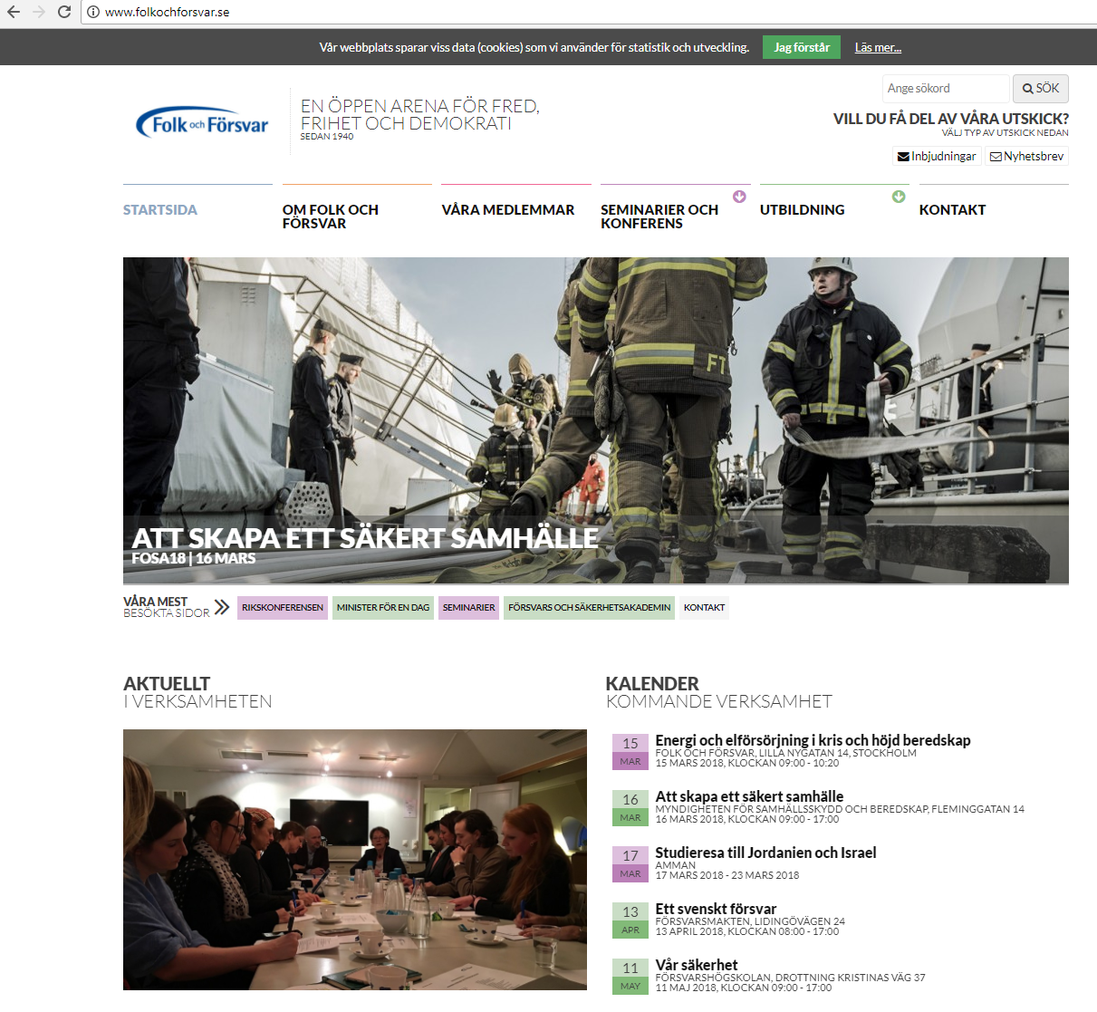
…and let’s talk of the “Folk och Försvar” (“People and Defense”) conference, which is the top security conference in Sweden
Attendees of security experts, politicians (including ministers), journalists, etc.

Slide 43
2015 Edition…
Activists from Pirate Party did set up an open WiFi called “Open Guest”
And of course most of the politicians and security “experts” used it…
Why extremely bad? Accessing confidential emails from government servers using non-encrypted protocols…
https://falkvinge.net/2015/01/14/hilarious-activists-turn-tables-on-political-surveillance-hawks-wiretaps-them-with-honeypot-open-wi-fi-at-security-conference/

Slide 44
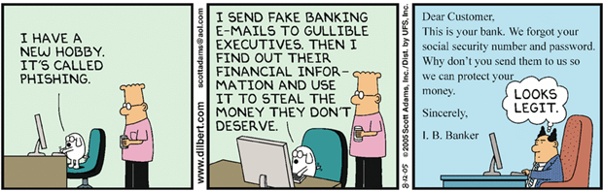
Phishing
“Phishing is the attempt to obtain sensitive information such as usernames, passwords, and credit card details (and money), often for malicious reasons, by disguising as a trustworthy entity in an electronic communication.” Wikipedia

Slide 45
Web Site Phishing
Somehow you need to trick a user to visit one of your malicious servers
You create a web page resembling the original target website (Facebook, Google, Amazon, their bank, etc)
Log when they type login/password
But how to trick a user to visit your web site?
Can use DNS poisoning
Can use web “links” in emails/chats/etc.

Slide 46
The ultimate phishing email???

Slide 47
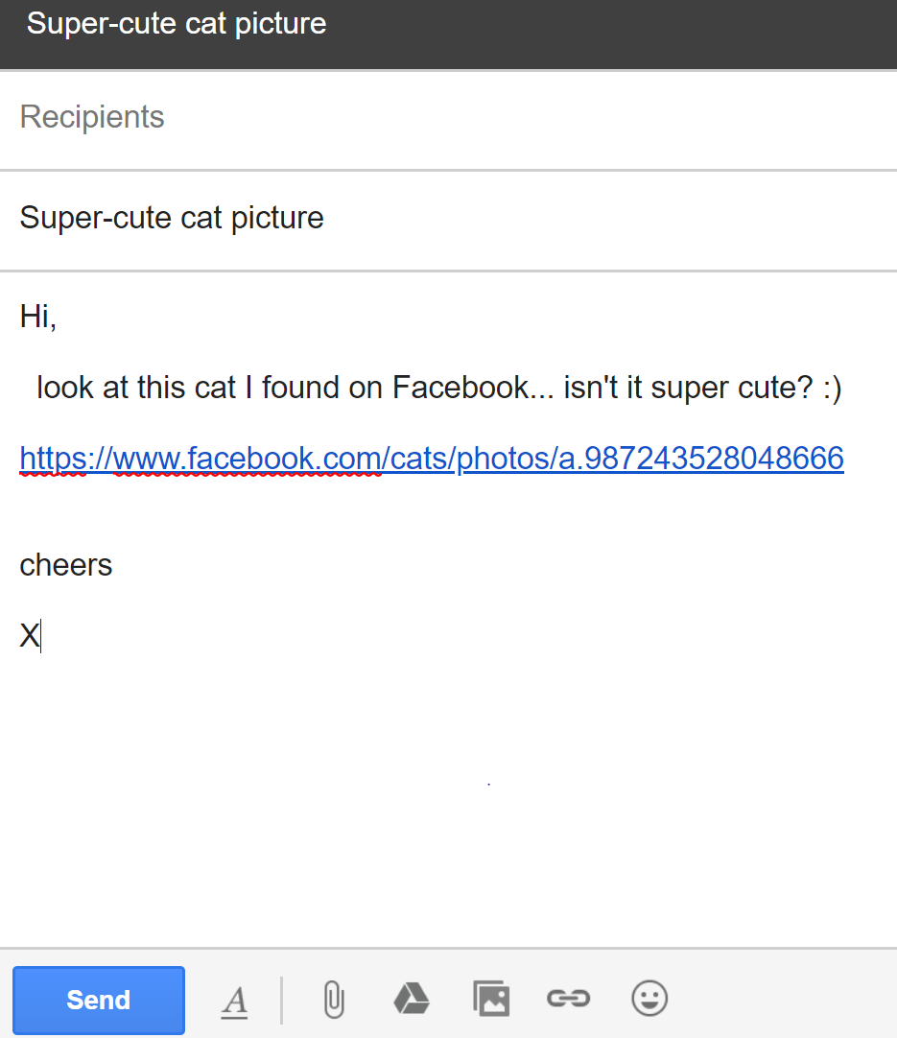
Who would have the strength to restrain from compulsory clicking that link without thinking twice???

Slide 48
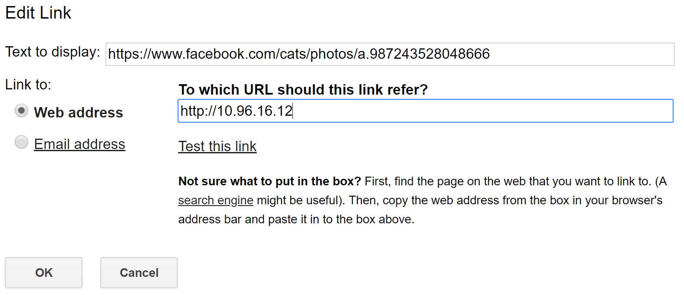
But the link is actually pointing to your evil web site… on which you are running a clone login page of Facebook…

Slide 49
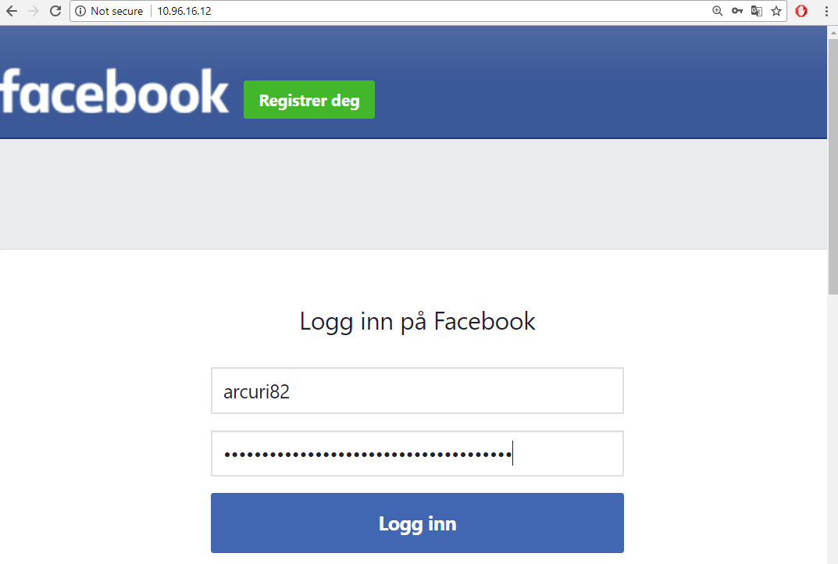

Slide 50
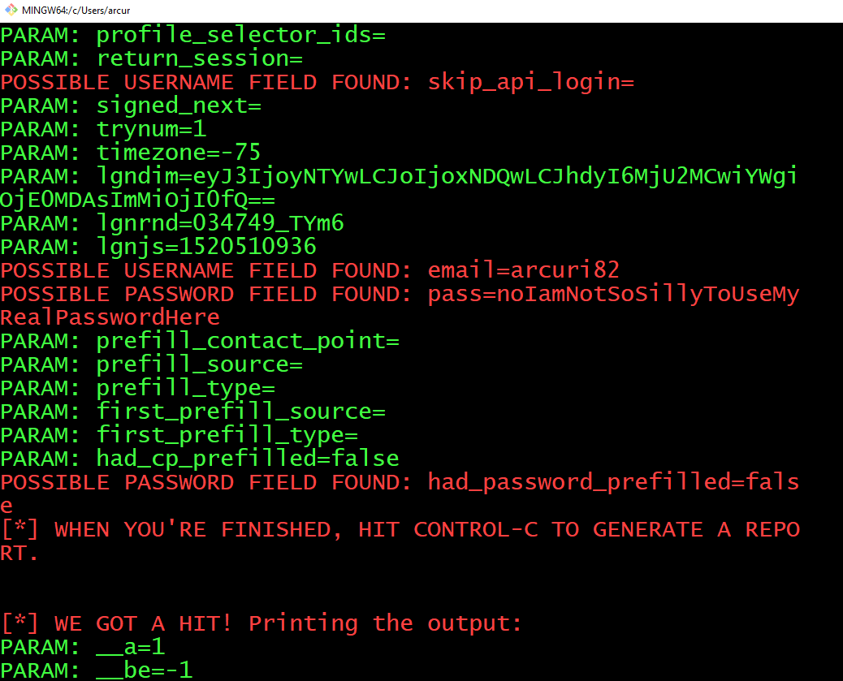
The POST in that HTML form does point to your server, where you can analyze if any sent data is a login/password

Slide 51
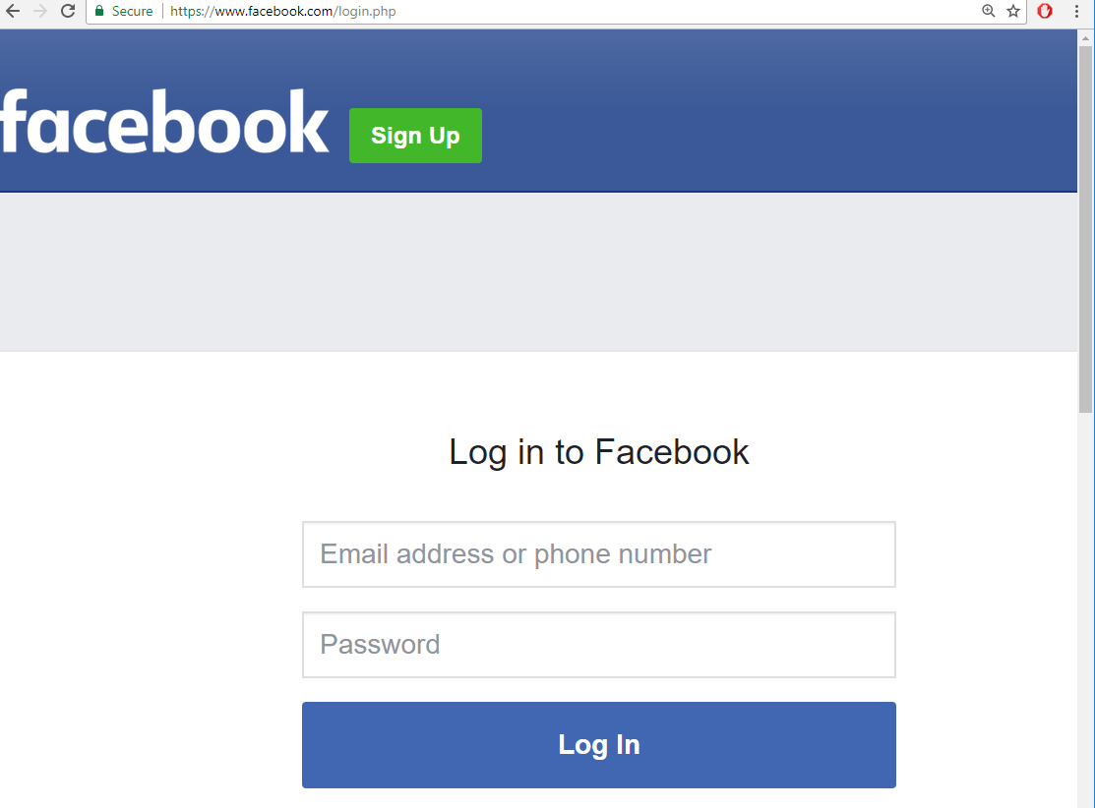
After first login attempt and password stolen, redirect to real website, so user would not suspect of what happened…

Slide 52
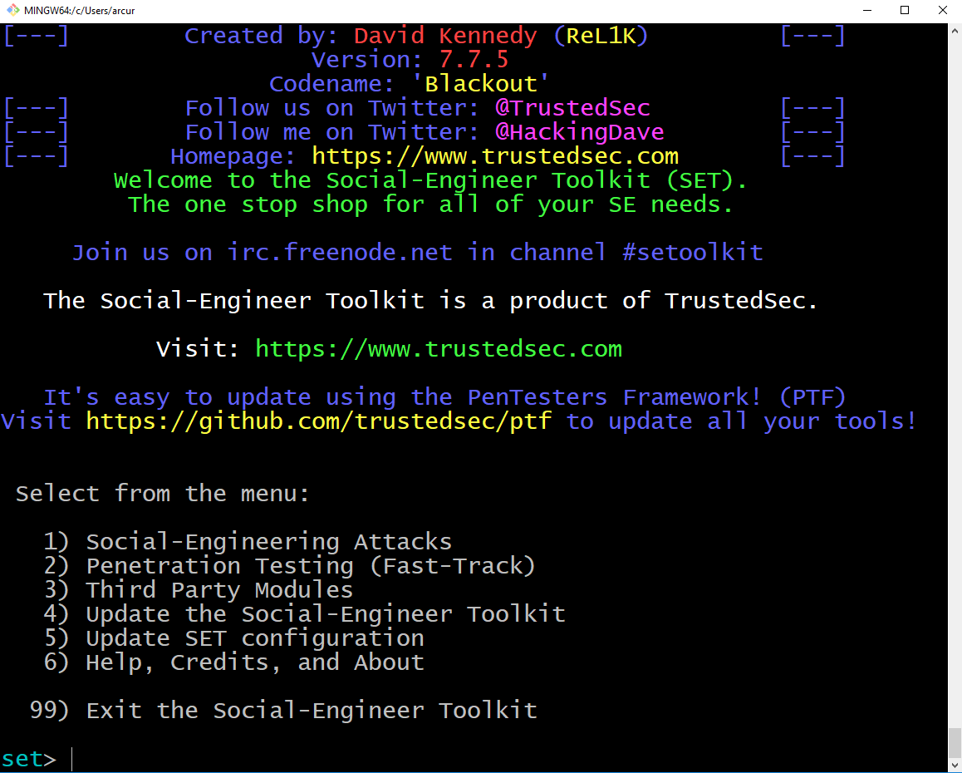
But it sounds like a lot of work…
Well, there are tools like setoolkit that can automate it
Creating a phishing site just takes a couple of minutes…

Slide 53


DO NOT DO IT
It is ILLEGAL, so target could call the police on you…
But, if you still do it, and have the brilliant idea to do it to your boyfriend/girlfriend as a prank, the police will be the least of your problems…
However, it will be the exercise for this week, between knowing students (but do not use your real passwords…)

Slide 54
DEMO

Slide 55
But would not the user see that the URL is weird???
Most people will have no clue…
To be more stealthy, you could register a hostname which is similar to the target
What happen if you type “facebok.com” (missing an “o”) in the browser?
To avoid phishing attacks, when you buy a hostname, also needs to buy hostnames that are similar (eg typos)

Slide 56
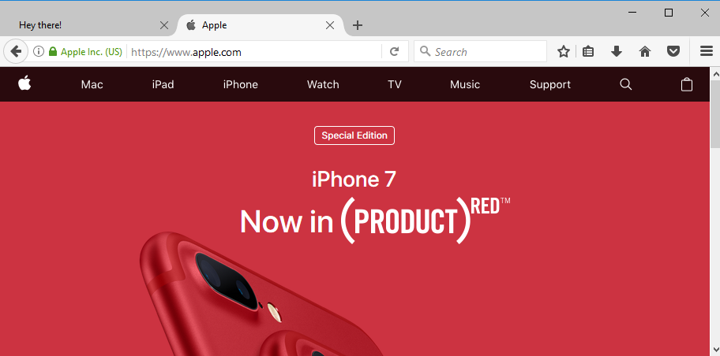

Slide 57
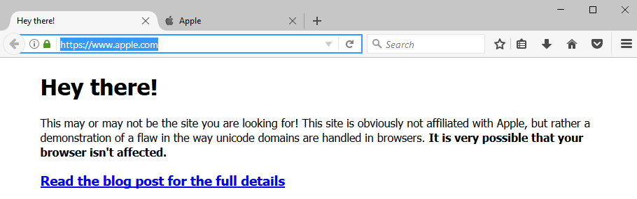
Still visiting www.apple.com, but this time the page looks slightly different… isn’it?

Slide 58
What the heck is going on???
The web page is obviously not the real www.apple.com
The actual page is www.xn--80ak6aa92e.com
Punycode: way to express UNICODE symbols with subset of ASCII for URLs
Important for displaying URLs with symbols from Chinese, Japanese, etc.
Eg, “xn--s7y.co” gets displayed in a browser URL bar with “短.co”
Cyrillic (Russia) has many symbols that are similar to Latin ones, but different Unicode values, eg Cyrillic "а" (U+0430) is different from ASCII "a" (U+0061)
“xn--80ak6aa92e” is representation of “apple” in punycode using only Cyrillic letters/fonts
At time of writing this slide, issue fixed in Chrome but not Firefox…

Slide 59
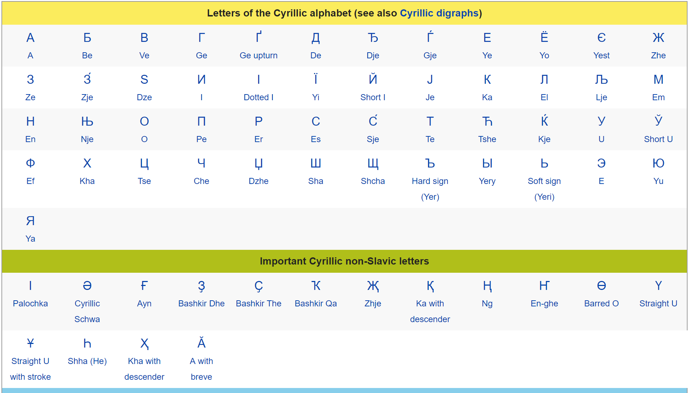

Slide 60
For Next Week
Book pages: 270-286, 349-350
Note: when I tell you to study some specific pages in the book, it would be good if you also read the other pages in the same chapter at least once
Exercises for Lesson 7 on GitHub repository

